Slide 1
Theory of Algorithms
MSYS30 Section C 1st Semester, SY20-21

Slide 2



Contact
francis.bautista07@gmail.com
fbautista@ateneo.edu
BS MIS 2015
MS CS 2022
Things I Like
Dogs
Football
Coffee
Cooking
Music
Francis Bautista
Lecturer, DISCS AdMU 2017-current
CEO/AI Engineer, Indigo Research 2017-current
AI Engineer, PLDT Global 2017-2018
Data Scientist, PLDT Talas 2015-2017
About Me
Fun Fact: I only started watching horror movies this year

Slide 3


We will be using Python primarily on Jupyter notebook environments. This class will not go into how these tools work due to time constraints. Please approach me if you’re unfamiliar with these tools.
Prerequisites
Let’s set things straight

Slide 4

This will be a programming class
Given the unique circumstances, you will be free to use whatever online resources you have available. Assessment will focus on algorithmic implementation rather than syntax.

Slide 5
Some math will be involved
It will only be basic arithmetic and will require a fundamental understanding of functions. Don’t worry, it’ll be very light and we’ll take it slowly.

Slide 6
Algorithm
A finite sequence of well-defined, instructions, typically to solve a class of problems or to perform a computation
Definitions are important

Slide 7
Why study data structures and algorithms?

Slide 8
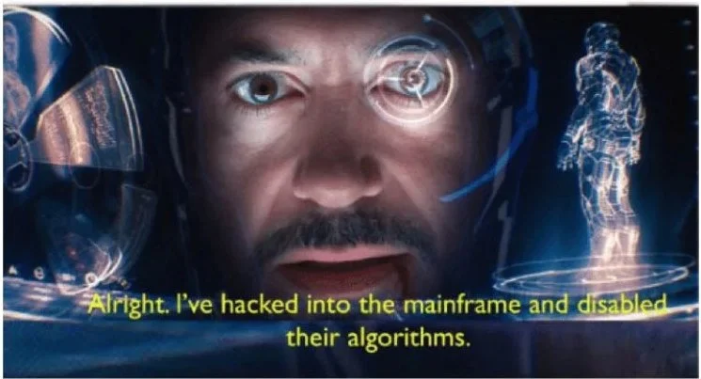

Slide 9
Why learn the fundamentals of programming?

Slide 10

solve problems
process information
learn new ways of thinking
Programs
allow us to

Slide 11
Good programs are founded on the following:
GOOD PROGRAMS
EFFICIENT ALGORITHMS
ORGANIZED INFORMATION

Slide 12
GOOD PROGRAMS
QUALITY PRODUCTION-GRADE CODE
EFFICIENT ALGORITHMS
ALGORITHMS
ORGANIZED INFORMATION
DATA STRUCTURES

Slide 13

systematic way of organizing, accessing, and storing information
collection of data, their relationships, and their functions
often components of larger programs
Data Structure
Representation and organization of information

Slide 14
systematic way of organizing, accessing, and storing information
collection of data, their relationships, and their functions
often components of larger programs
Data Structure
Representation and organization of information

Slide 15
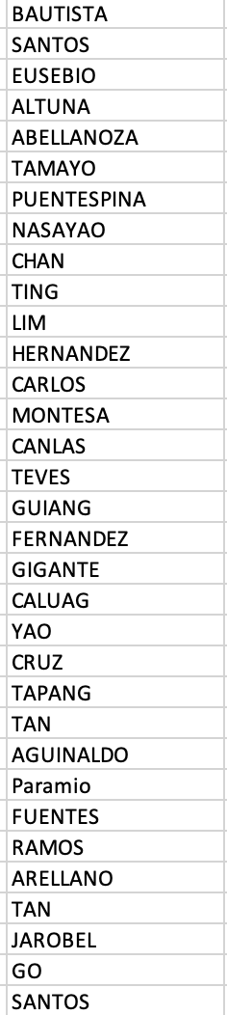
0 | 1 | 1 | 0 | 0
Lists and Arrays
a | c | z | e | d
Data structure containing elements/objects indexed by their position.
In computer science, the first position is always position 0.
1 | 2 | 3 | 4 | 5
000 | 001 | 010 | 011 | 100

Slide 16
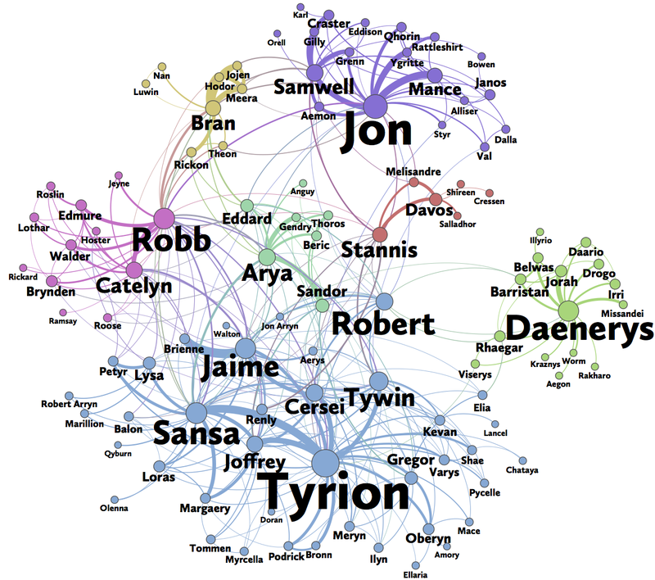
Graph or Network
Representation of information pertaining to relationships

Slide 17
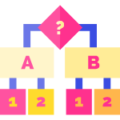
correctly solves a problem
instructions must be clear and unambiguous
must be expressed within a finite amount of space and time
Algorithm
Step-by-step procedure of performing a task in finite time

Slide 18
expressed in fewest number of steps as possible
easily understandable and reusable
consumes as little memory as possible
Good Data Structures and Algorithms
Performance and efficiency

Slide 19

Course Objectives
Design and recognize good data structures and algorithms.
Be able to write complex programs that implement algorithms and employ data structures.
Good Data Structures and Algorithms

Slide 20
Analysis and Comparison
Course Objectives
Different algorithms that solve a specific problem.
Different implementations and use-cases of data structures.
Good Data Structures and Algorithms

Slide 21
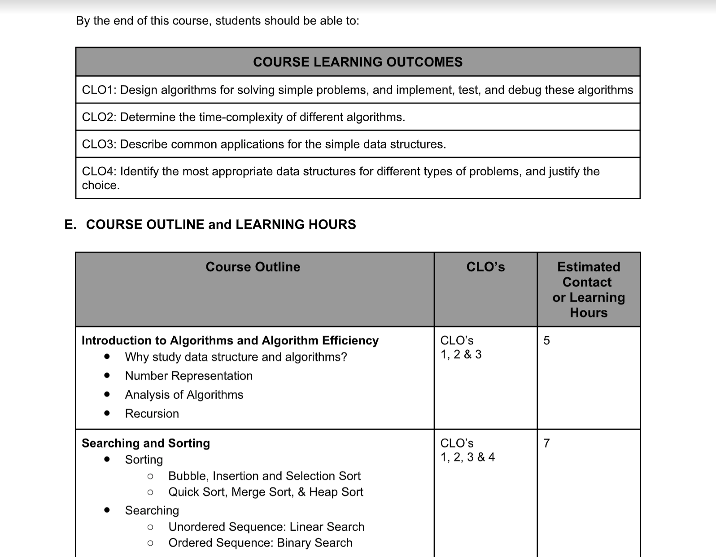

Slide 22
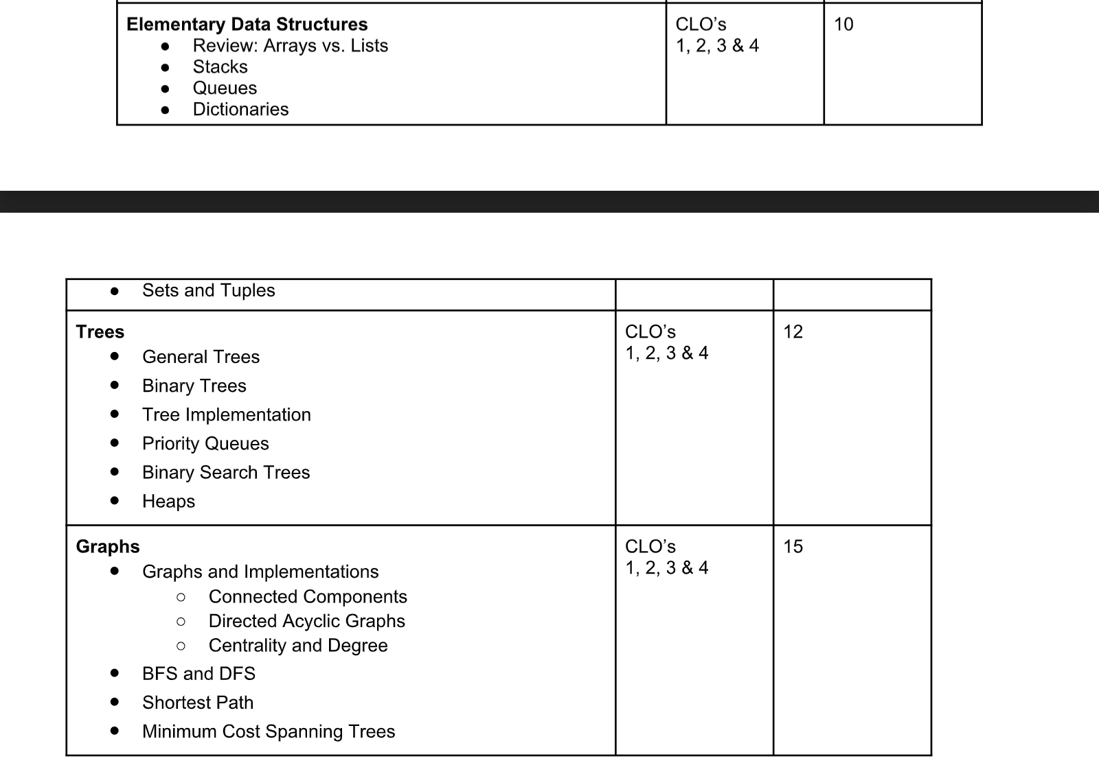

Slide 23
Class Format
Weekly async/sync online lecture with a light problem set at the end of the week
Grading based off whether the algorithm/question was implemented and analyzed correctly
Late submissions are accepted with a minor deduction
Problem Sets
Jupyter Notebook submissions online
Housekeeping and Grading Mechanics

Slide 24



Class Format
Zoom or Discord for sync sessions, with recordings uploaded to Youtube. Class materials and files on Moodle and Github.
Housekeeping and Grading Mechanics

Slide 25

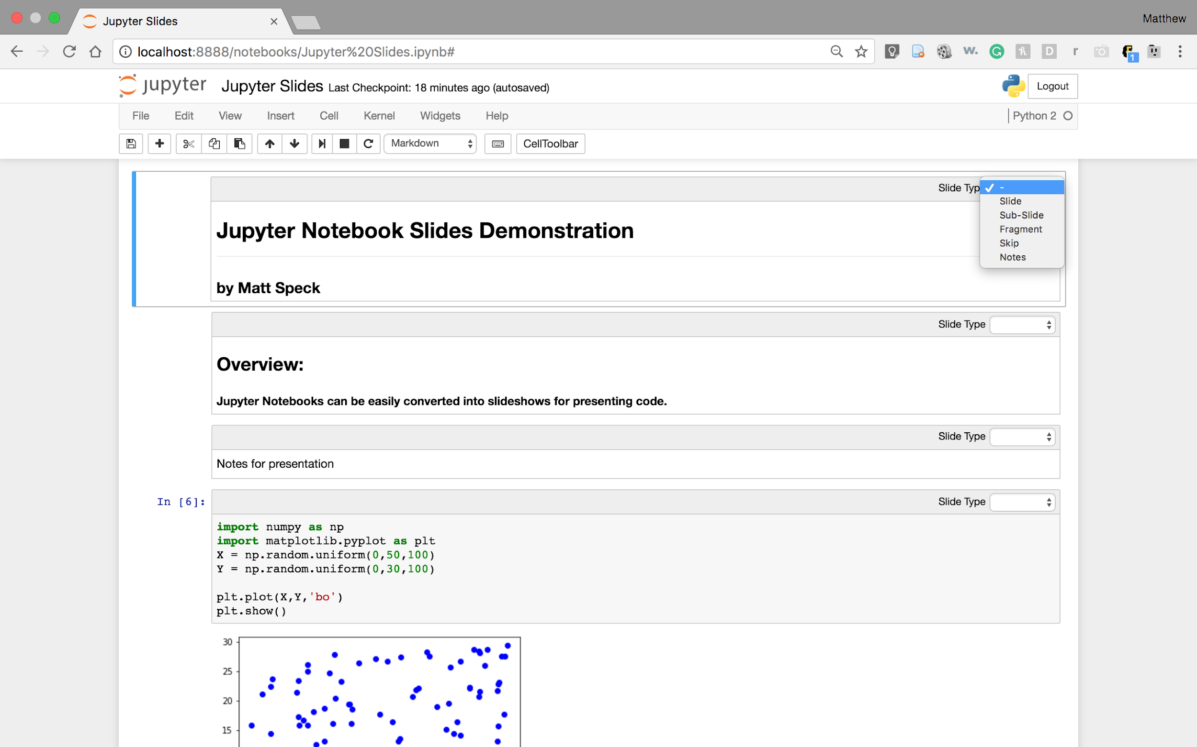
Homework
Check out Jupyter Notebooks.
https://jupyter.org/
We’ll be using them for interactive programming exercises.
Oh no, homework already.

Slide 26
Thank You
Have a great day!

